Slide 1
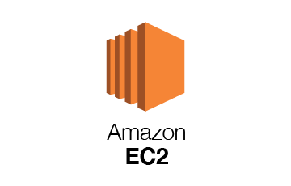
A Security Analysis of Amazon’s Elastic Compute Cloud Service
BASMA ADAWY

Slide 2
Agenda
Topic one
Topic two​
Topic three
Topic four
Introduction
Goal
Amazon EC2
Testing AMI Methodology
Results of AMI Analysis
- Software Vulnerabilities
- Security Risks (Malware, Unsolicited connections, Backdoors and Leftover Credentials)
- Privacy Risks ( Private key, Browser History, Shell History, Recovery of deleted files).
Machine Fingerprinting
Feedback
Conclusion

Slide 3
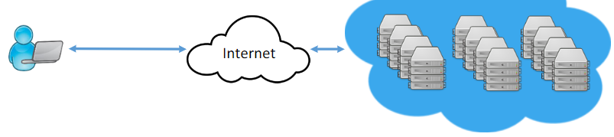
Introduction
Cloud computing provides scalable and measurable IT resources that are accessible via the internet. Servers can be quickly launched and shut down via application programming interfaces.
Cloud services can implement a wide range of functions, everything can be provided as a service XaaS.
Users can create and maintain online services with ease. Users are allowed to create and share virtual images, the cloud service provides customized public images based on common needs of their customers.
e.g. (Ubuntu image with pre-configured with MySQL, PHP and an Apache)

Slide 4
goal
To explore the security problems of the public Images available on the Amazon EC2 service.
There are three main threats :
1) secure the image against external attacks
2) secure the image against a malicious image provider
3) sanitize the image to prevent users from extracting and abusing private information left on the disk by the image provider.

Slide 5
Amazon ec2
Amazon Elastic Compute Cloud (EC2) is an Infrastructure as-a-Service (IaaS) where users can rent virtualized servers (instances) on an hourly base to run pre-installed VM images called Amazon Machine Image (AMI).
Amazon offers an online catalog where users can choose an AMI with pre-installed services to suit his needs.

Slide 6
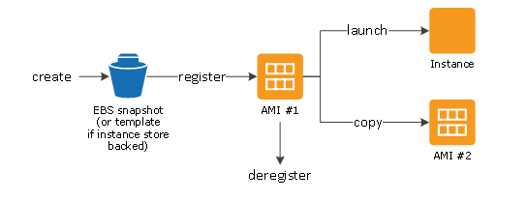
Cont. Amazon ec2 What is ami?
An AMI is a template that is used to create a new instance—or virtual machine—based on user requirements. The AMI will contain information about the software, operating system, volume, and access permissions.
There are two types of AMIs:
Predefined AMIs: Amazon creates these, and the user can modify them.
Custom AMIs: The user also creates these, and they can be reused.

Slide 7
Cont. amazon ec2
Public images may be available for free or may be with bill via the Amazon DevPay payment service.
to start an image:
the user should select a resource configuration (processing, memory, and IO performance).
set of credentials that will be used for login, and firewall configuration for inbound connections (called a security group) and the region of the data center.
When an AMI is instantiated, its public DNS address is announced via the Amazon API, and the machine is made accessible via SSH on port 22 (Linux) or Remote Desktop on port 3389 (Windows).

Slide 8
Ami testing methodology
An automated system was developed to instantiate and test the Amazon's AMIs.
The architecture consists of three main components:
Robot = Responsible for instantiating the AMIs and fetching the corresponding login credentials.
and for the credentials configuration The tool was configured to try a list of the most common usernames (e.g. root, ec2-user, ubuntu .. etc.)
After successfully instantiated of AMI by the Robot, it is tested by two different scanners.
2) Remote Scanner = Collects the list of open ports by using NMap tool and downloads the index page of the installed web applications
3) Local Scanner = Component is responsible for uploading to the AMI and running a set of tests with administrative privileges .
It also analyzes the system for known vulnerabilities using the Nessus tool.

Slide 9
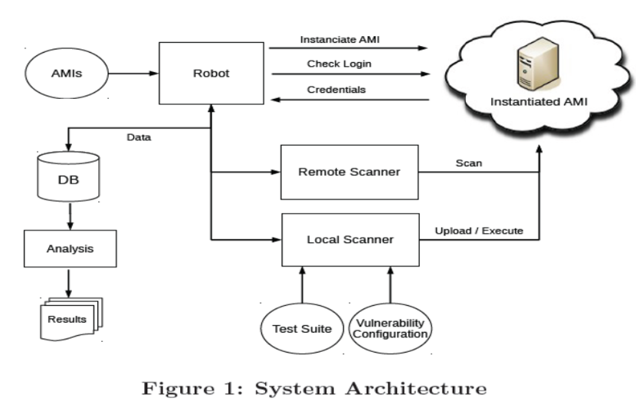
Cont. Ami testing methodology

Slide 10
Cont. Ami testing methodology
The test suite uploaded by the Local Scanner includes 24 tests grouped in 4 categories:
general, network, privacy, and security.
General = Collection of general information about the system (e.g. Linux or Windows version), running processes, file-system status, installed packages, In addition save a copy of interesting data.
example:
emails (e.g. /var/mail ), log files (e.g. /var/log), installed web applications (e.g. /var/www).
2) Privacy = Collects sensitive information about user that may have been forgotten
by the user that published the AMI and scan the filesystem to retrieve the contents of undeleted files.
example:
unprotected private keys, shell history logs, installed application history files.

Slide 11
Cont. Ami testing methodology
3) Network = collects Information related to network.
such as:
shared directories, The list of open sockets used to verify the image.
4) Security = consists of a number of Well-known audit tools for (Windows and Linux). These tools looking for the evidence of known rootkits, Trojans and backdoors by using (Rootkit tools).
Specifically run the ClamAV antivirus software for scanning the presence of malware.
These security tests also contain checks for credentials that have been left or forgotten on the system (e.g., database passwords, login passwords, and SSH public keys).
Those credentials could potentially be used as backdoors to allows attackers to log into running AMIs.

Slide 12
Result of the Amis analysis
Automated system was used to instantiate and analyze all Amazon images available in the Europe, Asia,
US East, and US West data centers
AMIs analysis were successfully done, But in some cases an AMI did not start because some files were missing or corrupted, the running image was not responding to SSH, the Amazon API failed to launch the machine or robot was not able to retrieve valid login credentials.
Analysis result of AMIs on individual test suites:
1) Software Vulnerabilities
2) Security Risks
3) Privacy Risks

Slide 13
cont. Result of the Amis analysis Software vulnerabilities
The goal of this phase is to test the software running on each AMI is out of date or not. If the software is out of date, then must be immediately updated by the user after the image is instantiated.
This was done using Nessus, an automated vulnerability scanner to classify each vulnerability with a severity level ranging from 0 to 3 on each AMI under test.
Vulnerability with high severity e.g., critical vulnerabilities such as remote code execution.
Observed that mostly images come with pre-installed software that is more than two years old.
Renting and using an AMI without any adequate security assessment poses a real security risk for users.

Slide 14
cont. Result of the Amis analysis Security risks
In security risk assessment:
Malware
Unsolicited connections
Backdoors and Leftover Credentials

Slide 15
cont. Result of the Amis analysis Security risks
Malware :
By using ClamAV an opensource antivirus engine, to analyze the filesystem on the target AMI.
ClamAV contains about 850,000 signatures to identify different types of known malware instances such as viruses, worms, spyware, and trojans.
In malware analysis two infected AMIs has discovered both are Windows-based.
First machine was infected with a TrojanSpy malware. Trojan has a wide range of capabilities, including performing key logging, monitoring processes on the computer, and stealing data saved on the machine.
Also Trojan.Firepass, a tool to decrypt and recover the passwords stored by Firefox.
Second machine was infected with Trojan.Agent malware. This malware allows a malicious user to spy on the browsing habits of users, modify Internet Explorer settings, and download all malicious content.

Slide 16
cont. Result of the Amis analysis Security risks
2) Unsolicited connections
Such connections could be the evidence of some kind of backdoor, or the sign for a malware infection.
The Linux operating system comes with a service called syslog for recording various events generated by the system. (e.g. the login and logout of users, the connection of hardware devices). Record of these kinds of events usually stored in var/log directory of a Linux system and only users with administrative privileges are allowed to access the logs
During the analysis two AMIs has found in which the syslog daemon was configured to send the log messages to a remote host basically its out of the control of the user, the information of image stored in local protected directory were sent out to a third-party machine.

Slide 17
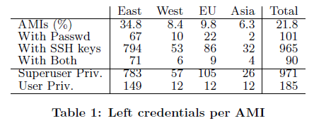
Cont. Security risks
3) Backdoors and Leftover Credentials
to connect to a Linux machine remotely is through the ssh service. When a user rents an AMI, he is required to provide the public part of the his ssh key that it is then stored by Amazon in the authorized_keys in the home directory.
First Problem if user didn’t remove his public key from the image before making it public, it’s information will be shared to public cloud.
Second problem is related to SSH server permit password-based authentication and providing a backdoor functionality if the AMI provider does not remove his passwords from the machine.
Leftover ssh keys only allow people with the corresponding private key (normally user got during creating a new AMI) to obtain access. 21.8% of the scanned AMIs contain leftover credentials that would allow a thirdparty to remotely login into the machine

Slide 18
cont. Result of the Amis analysis Privacy risks
Attacker can gather SSH private keys to break into other machines start instance or use forgotten Amazon
Web Services (AWS) keys to start instances at the image provider's cost.
But Inaddition data sources such as the browser and shell history can be used to identify the AMI's.
For the privacy issue we will discus about:
1) Private key
2) Browser History.
3) Shell History.
4) Recovery of deleted files.

Slide 19
cont. Result of the Amis analysis Privacy risks
Private key
A number of tests were developed to search the AMIs filesystem for typical filenames used to store keys for SSH keys, and AWS API keys
We found that Amazon API keys, and private SSH keys were forgotten on the AMIs.
This can be used to start images on the cloud at the expense of the key's owner.
By consulting the last login attempts (i.e., by lastlog), an attacker can easily retrieve IP addresses that likely belong to other machines owned by the same person.

Slide 20
cont. Result of the Amis analysis Privacy risks
2) Browser History
The scripts is used to check which domains had been contacted before. From the automated analysis of the history file, we discovered that one machine was used by a person to log into the portal.
Then same user again logged into his personal Google email account.
Combining these kinds of information, history files can easily used to reveal information about the image's creator.

Slide 21
cont. Result of the Amis analysis Privacy risks
3) Shell History
When sensitive information such as a password or a credit card number is transferred to a web application using an HTTP GET request. GET requests are stored on the web server's logs.
For-example credentials that can be used to access and modify the domain name information of a dynamic DNS account. A malicious user that obtains a DNS management password can easily change the DNS configuration and redirect the traffic of the original host to his own machines.

Slide 22
cont. Result of the Amis analysis Privacy risks
4) Recovery of deleted files
When a user deletes a file, the space occupied by the file is marked as free, but the content of the file physically remains on the media (e.g. hard-disk). The contents of the deleted file lost only when this marked space is overwritten by another file.
When file is deleted or overwritten it is possible to use tools (e.g. extundelete for ubuntu and Winundelete for window) to recover deleted files.
During the analysis of Linux AMIs and Windows AMIs we are able to recover deleted files from four different regions (US East/West, Europe and Asia) by these tools.

Slide 23
Machine fingerprinting
Number of the issues we described could be exploited by an attacker (or a malicious image provider) to obtain unauthorized remote access to any running machine that adopted a certain vulnerable AMI.
Three different approaches was used to match and map a running instance of AMIs.
methods are based on the comparison of the SSH keys, versions of network services, and web-application signatures.
SSH matching.
2) Services matching.
3) Web matching.

Slide 24
Cont. Machine fingerprinting
1) SSH matching
Every SSH server has a host key that is used to identify itself and to verify the authenticity of the server. Host key of an image needs to be regenerated upon instantiation of an AMI for two reasons:
First, a host key that is shared among several machines makes these servers vulnerable to man-in-the-middle attacks (i.e., especially when the private host key is freely accessible).
Second, an unaltered host key can serve as an identier for the AMI.
In such cases, it is very easy for an attacker to match the SSH keys extracted from the AMIs with the ones obtained from a simple NMap scan.

Slide 25
Cont. Machine fingerprinting
2) Service matching
In the cases where the SSH-based identification failed then compare the banners captured by NMap with the information extracted from the services installed on the AMIs (e.g. service name and service version ).
it may produce false positives if the user has modified the running services.
Since most services installed on the AMIs were old and out of date, it is very unlikely that new services (or updated ones) will match the same banners as the one extracted from the AMIs.
This will likely decrease the matching rate and unluckily generate false positives.

Slide 26
Cont. Machine fingerprinting
3) Web matching
In AMI matching approach:
web information were collected from all the instances that had ports 80 and 443 open. Compared this information with the collected data during the scan of the Amazon AMIs.
First phase WhatWeb tool was used to extract the information about name and version of installed web server, configuration details and the installed interpreters.
Second phase compared information to the scanned AMIs and check for machines with same configurations.

Slide 27
feedback
To dealing with the security issues. AWS Security Team. first contacted the affected customers and provided information about their credentials that were left on public AMIs.
The security team take action on behalf of the user that couldn’t be reached and changed the status of the vulnerable AMI to private.
The security team released a tutorial to help customers share public images in a secure manner.
Then AWS security team also provide a solution to prevent the recovery of private documents by undeletion.
Port scanner with limited number of ports scanned (i.e, 30) and the very low volume of packets per second was used to scan running images to identify open ports.

Slide 28
conclusion
Users must update the software when they use cloud images.
Users using cloud services must have knowledge about security risks to keep their data secure.
Cloud services aren’t the best choice in all cases.
Cloud providers must verify and improve the security for their services.
Communication between users and cloud providers increases the security level and services.

Slide 29
Thanks

